Slide 1


How are We Going to Get Paid Tomorrow… and How do We Prepare Today?
Dale Jarvis, CPA
www.djconsult.net

Slide 2
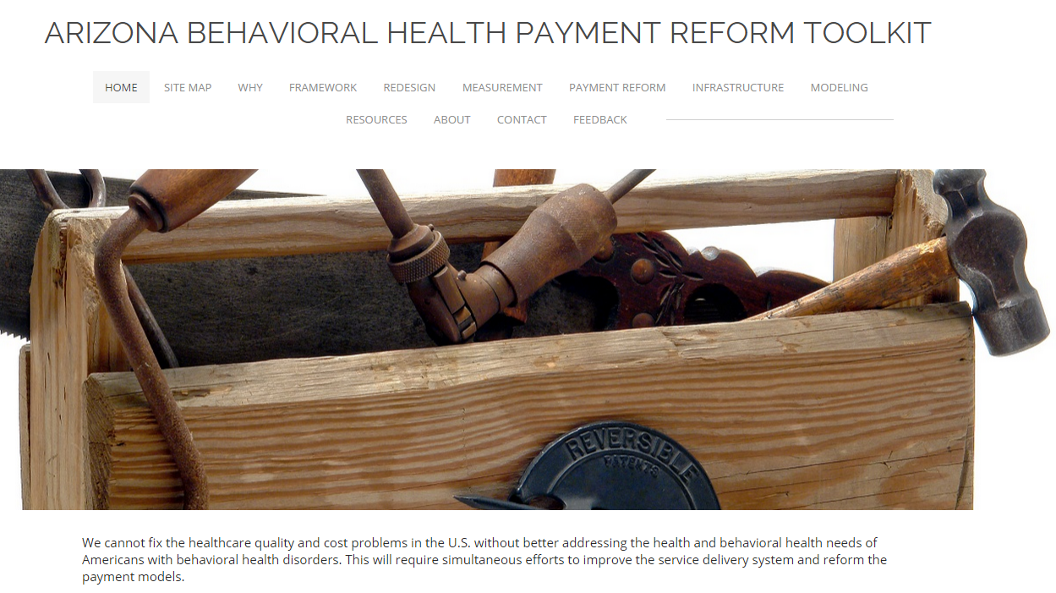
How Are We Going to Get Paid Tomorrow: Short Answer
Through one of Four Payment Models
Each with a Pay for Performance Layer

Slide 3
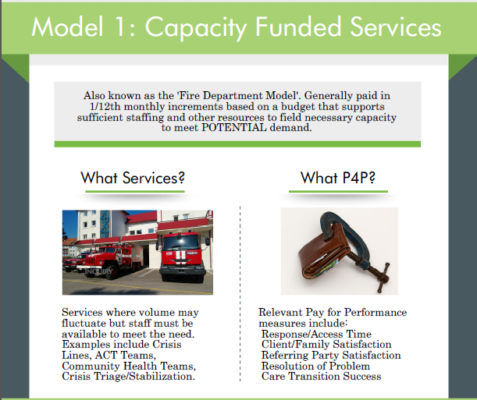

Slide 4
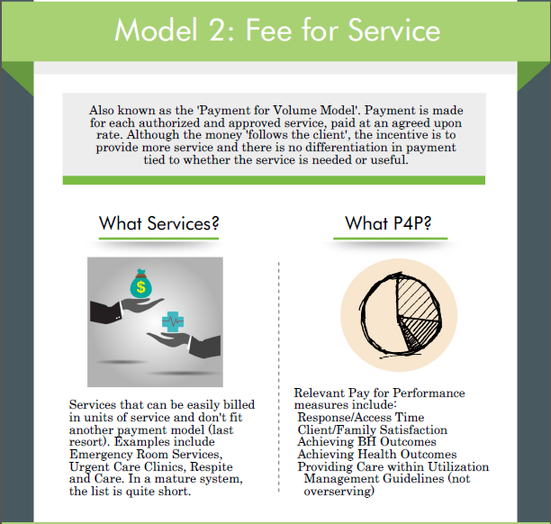

Slide 5
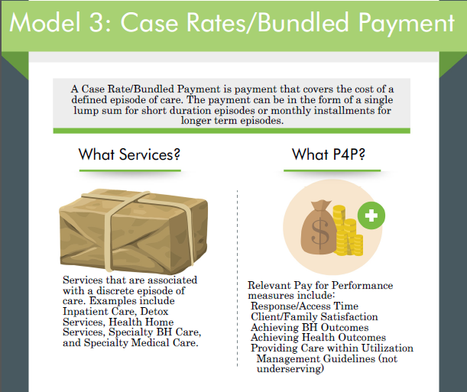

Slide 6
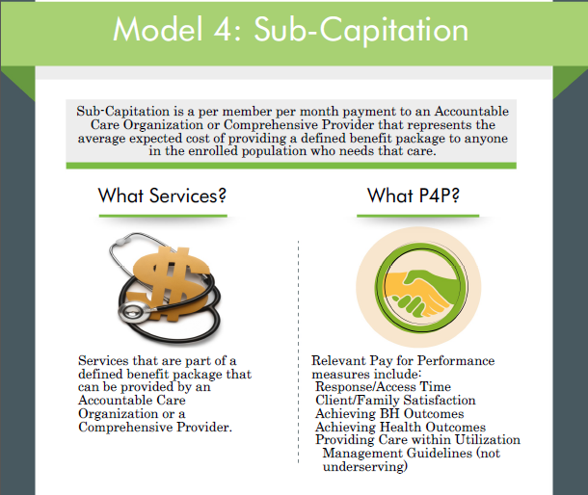

Slide 7
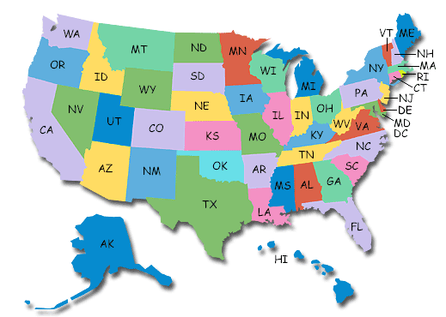

How Do We Prepare Today?
7

Slide 8

The Future Looks Quite Bright
And if you work in Behavioral Health
More money
More collaboration
More success
More respect
Why?

Slide 9
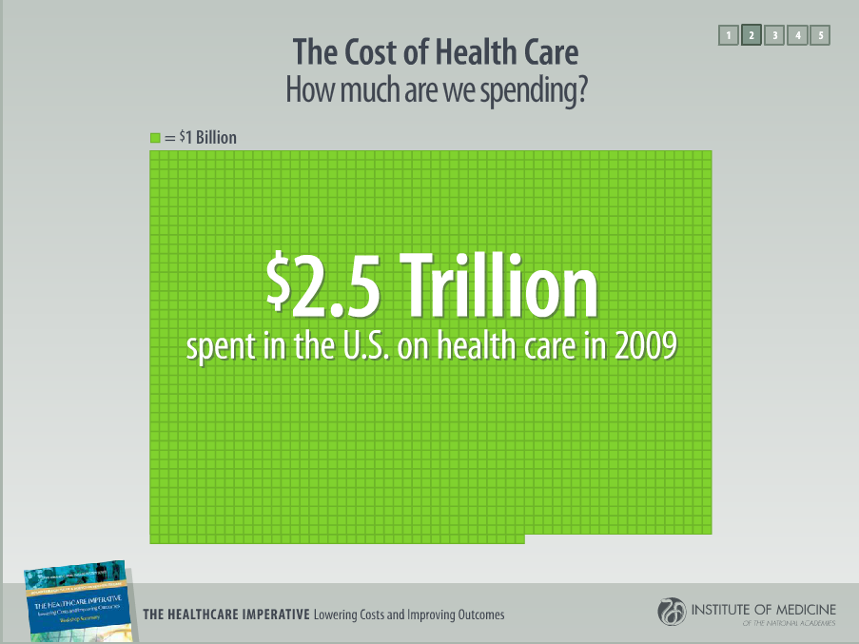
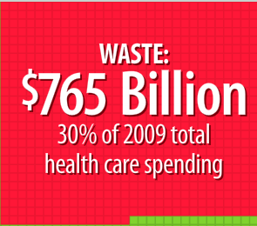
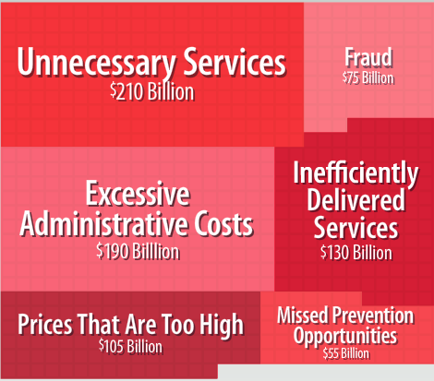
30% Waste

Slide 10
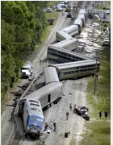

And for Folks with
Behavioral Health Disorders
Insufficient Evidence that BH Care is Working
High Rates of Untreated Chronic Health Conditions
Too Much Sick Care
Medical Specialty Procedure Based Care
Diagnostic Imaging
Medical and Psychiatric Inpatient
Too Little Effective Care
Big Gaps between BH Need and Capacity
Crisis and Emergency Room Care

Slide 11

Purchasers, Payors, CEOs
Are quickly learning
5% of the population uses 50% of the resources
Half of the 5/50 population have Behavioral Health Disorders

Slide 12
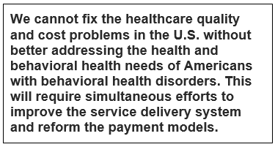
The Arizona Project
http://azpaymentreform.weebly.com/

Slide 13



CEOs in the Medical System Realize
“In health care, the days of business as usual are over.”
“It’s time for a fundamental new strategy.” “We must…
  Shift the focus from volume to patient outcomes achieved
  Replace today’s fragmented system with a system in which services are concentrated in health-delivery organizations”

Slide 14

The CEOs Also Understand
Behavioral Health screening, assessment, and treatment must become embedded in the day to day workflows of their operations
The alternative…

Slide 15
The Future Looks Quite Bright
And if you work in Behavioral Health
More money
More collaboration
More success
More respect
The Catch?
You may not be working for the same organization in 3 to 5 years!

Slide 16

Skating to Where the Puck is Going
Four key strategy questions*:
  What vision do we
  want to pursue?
  How will we make a
  difference?
  How will we succeed?
  What capabilities will
  it take to get there?
  (* The Strategic Plan is Dead. Long Live Strategy. Dana O’Donovan &
  Noah Rimland Flower. Stanford Social Innovation Review. January 2013.)

Slide 17
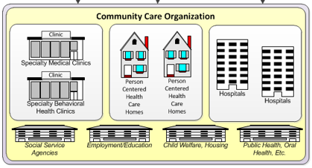
The Vision: Health Neighborhood
The future is in One-Stop Health and Wellness Centers providing Integrated Whole-Health Care (physical and virtual).
Combined with specialty care (medical and behavioral health; inpatient and ambulatory) provided at Centers of Excellence.
Plus Community Services & Supports that address the social determinants of health.
All customized to meet the needs of a given Health Neighborhood.

Slide 18
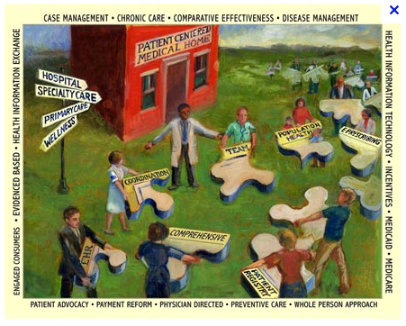
How Will We Make a Difference?
Help your Clients Achieve their Behavioral Health Treatment Goals.
Help your Clients Achieve
their Whole Health Needs.
Pursue Population-Based
Health Strategies:
  Identify and Engage those
  with BH Needs who are
  NOT in Treatment.
Help Address Health Behaviors of those with Chronic Medical Conditions, with an Emphasis on those in the 5/50 Population.

Slide 19

How Will We Succeed?
You need to navigate to a place where your organization is seen by your community a Behavioral Health Center of Excellence.
  (i.e. the Mayo Clinic of Behavioral Health)

Slide 20

BHCOE Defined
Our organization is known by
the entire community as a
great place to get care and a
great place to work.
We are an integral part of the health neighborhood, providing (1) easy access to
(2) comprehensive, (3) cost effective care that results in (4) excellent outcomes and (5) high client satisfaction.

Slide 21
What Does this Look Like?
Let’s Take a Quick Tour…

Slide 22

BHCOE = 1) Easy Access
“Be there when I need you.”
– Oregon Patient-Center Primary Care Home Program principles
A BHCOE is known for ensuring that new and continuing clients are able to get the right care, at the right time, in the right setting, by the right provider.

Slide 23
BHCOE = 2) Comprehensive Care
“Provide or help me get the
health care and services I need.”
— Oregon PCPCH Principles
A BHCOE is known for offering a broad scope of mental health, substance use, and co-occurring disorder treatment services that are integrated with medical care and other services and supports.
There are very few organizations that can do it all. But, that doesn’t get you off the hook.

Slide 24
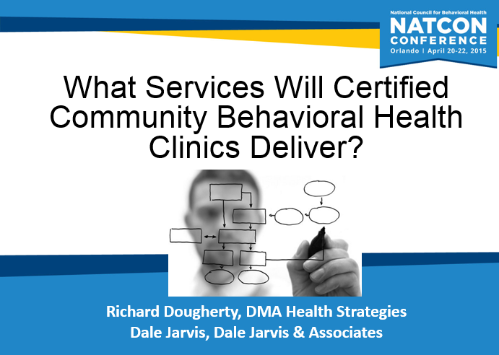

Slide 25
10 Required CCBHC Services
The Excellence in Mental Health Act has identified ten required services that must be provided by every Certified Community Behavioral Health Clinic (CCBHC) in the United States.
Crisis Services: 24 hour mobile, crisis intervention and stabilization
Screening assessment and diagnosis including risk assessment
Patient centered treatment planning
Outpatient mental health and substance abuse services
Targeted Case Management
Psychiatric Rehab Services
Peer support and family support
Care for members of armed forces and veterans
Outpatient clinic primary care screening and monitoring
Care Coordination: coordinating care with a host of other providers

Slide 26
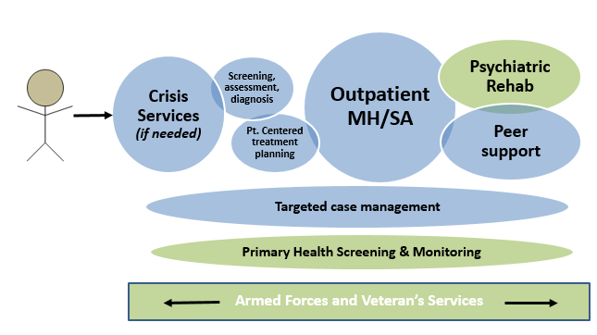
9 Required CCBHC Services

Slide 27
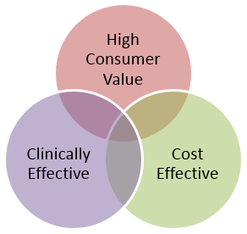
BHCOE = 3) Excellent Value
Accessible care provided by staff that communicate well..
Achieves individual and systemwide outcomes
Costs less than alternatives with comparable outcomes

Slide 28

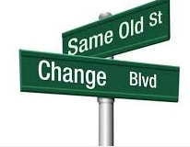

BHCOE = 4) Excellent Outcomes
A Behavioral Health Center of Excellence is known for achieving results for clients.
The organization can measure what is important to clients and achieve excellent outcomes on those measures.
P.s. Pay for Performance is a vehicle for incentivizing and rewarding organizations that commit to this journey.

Slide 29

Excellent Outcomes
Bucket 1: The work
we do makes a measurable difference in people’s lives and we can demonstrate our excellent outcomes and high success rates with data (using validated clinical instruments).
Bucket 2: We can’t make the above statement either because we aren’t measuring well (but we believe we provide great care), or we have started tracking outcomes and we’re not as great as we thought.

Slide 30
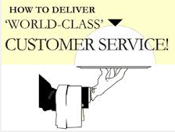
BHCOE = 5) World Class
Customer Service
Job 1: Create an organization that is a great place to work and is made up of individuals who believe deeply in resiliency and recovery.
Where all staff are focused on their own physical and emotional wellness in order to support a journey to wellness for their clients.

Slide 31

Employee Engagement

Slide 32



The Energy Project

Slide 33
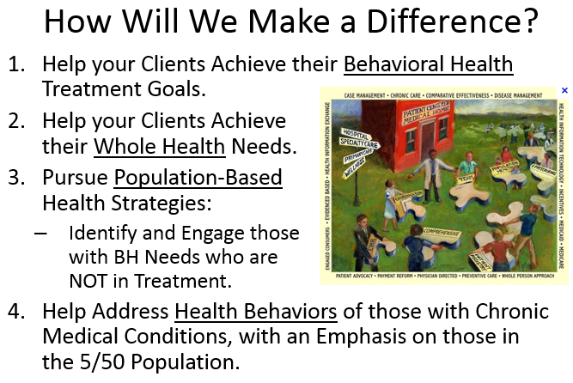
  What capabilities will it take to get there?
Only two
  Close any
  gaps:
  Prepare for
  Value-Based
  Purchasing
  the Arizona
  Way, drawing on the resources in the Arizona Behavioral Health Payment Reform Toolkit and the webinars we will be holding.

Slide 34
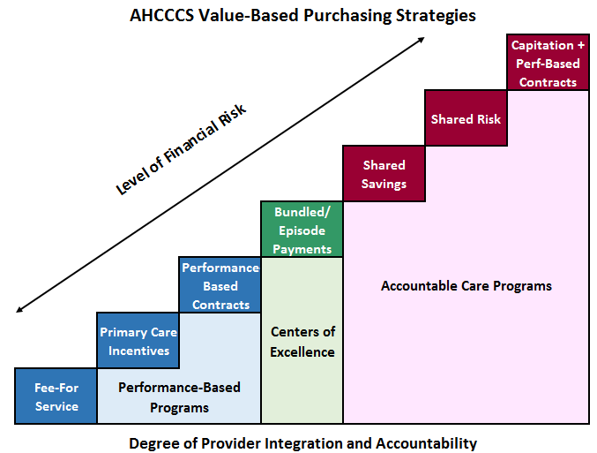
AZ VBP At-A-Glance

Slide 35
After Spending Several Months Working on a Project in Arizona…
I have seen the Future of Behavioral Health Payment Reform.
And it’s starting to happen right here in Arizona.
Led by Tom Betlach, Director of AHCCCS.
And a cast of dozens at AHCCCS, DBHS, the RBHAs and Providers.
It’s going to start slow, beginning with the RBHA Value-Based Purchasing Plans.
Don’t be seduced by the pace; it will be slow in the beginning, but will accelerate.
Make sure you’re faster out the gate with your prep work!

